Slide 1



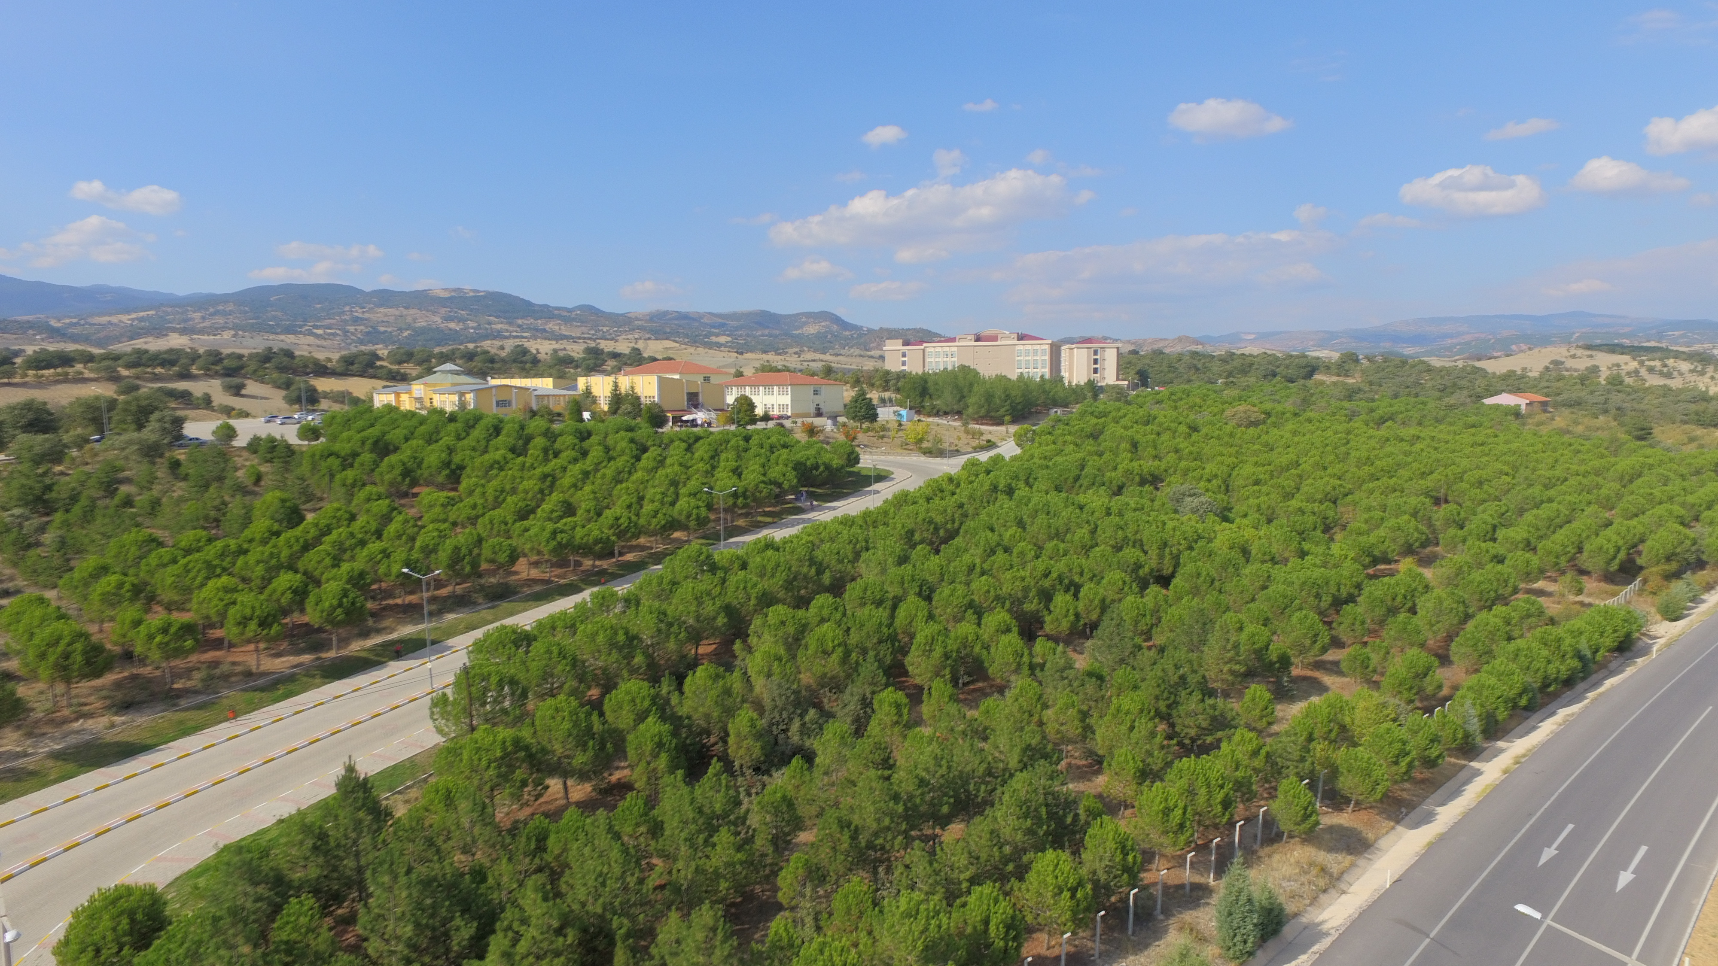
BAŞLIK/TITLE
Author
Author
Author

Slide 2
INTRODUCTION
Brief explanation of the research problem
Gap between existing studies and real conditions
Background
Research Problem
………
…………………..
Research Objectives
…………….
Research Benefits
Scope and Limitations
Importance of the topic in current scientific or practical context
Research Benefits

Slide 3
INTRODUCTION
1
Background
…..
2
Research Problem
......
3
Research Objectives
……..
4
…….
Research Benefits
Scope and Limitations
Research Benefits

Slide 4
INTRODUCTION
1
Background
…..
2
Research Problem
……
3
Research Objectives
……
4
……
Research Benefits
Scope and Limitations
Research Benefits

Slide 5
INTRODUCTION
1
Background
Academic
………
Research Problem
2
Practical
Research Objectives
………..
Research Benefits
3
Policy or professional implications
………
Scope and Limitations
Research Benefits

Slide 6
INTRODUCTION
Background
………….
Research Problem
Research Objectives
………………
Research Benefits
Scope and Limitations
Research Benefits

Slide 7
LITERATURE REVIEW
Theory 1
Theory 2
Theory 3
……..
……….
…….

Slide 8
……..
……..
Study Design
Data collection Techniques
……..
…….
Research Location
RESEARCH METHODOLOGY
Data analysis Methods
……..
…………..
Sampling Method
Research
Ethics

Slide 9
RESEARCH METHODOLOGY
Number of participants
……..
Age / gender / relevant characteristics
……..
RESEARCH SAMPLE
Inclusion criteria
…….

Slide 10
RESEARCH RESULTS
Variable | Category | Frequency (n) | Percentage (%)
Gender | Male | 42 | 420
 | Female | 58 | 580
Age (years) | 18–30 | 35 | 350
 | 31–50 | 45 | 450
 | >50 | 20 | 200
Total |  | 100 | 100
Characteristics of Study Participants
………..
Main
Research Findings
Relationship Between Variables
Data shown are simulated for presentation purposes.

Slide 11
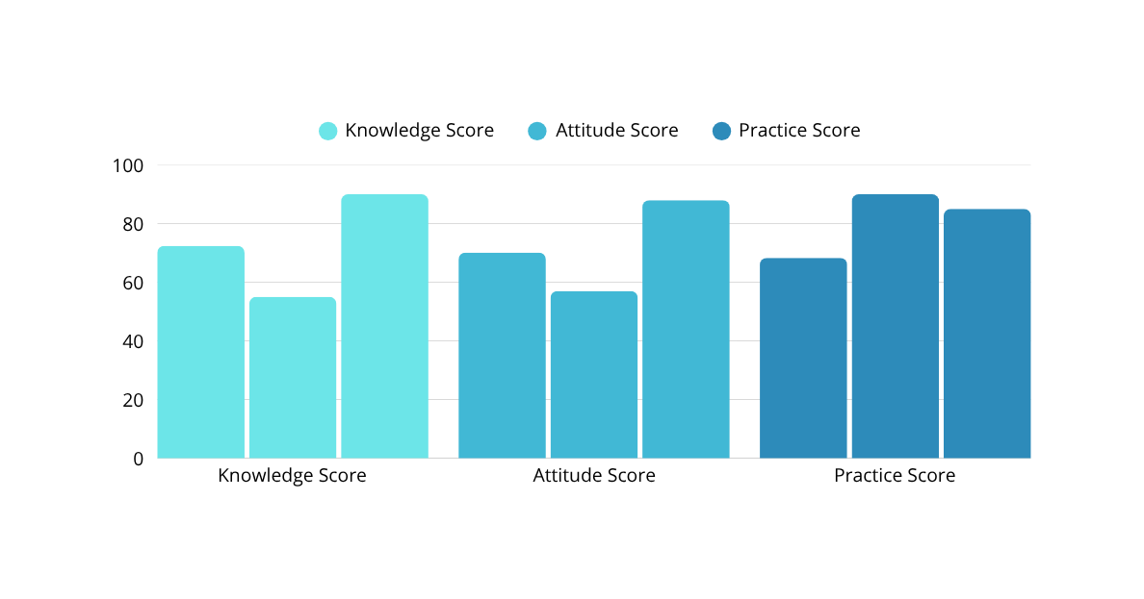
RESEARCH RESULTS
Characteristics of Study Participants
Main
Research Findings
…….
Variable | Mean ± SD | Minimum | Maximum
Knowledge Score | 72.4 ± 8.6 | 55 | 90
Attitude Score | 70.1 ± 7.9 | 57 | 88
Practice Score | 68.3 ± 9.2 | 50 | 85
Relationship Between Variables
Data shown are simulated for presentation purposes.

Slide 12
RESEARCH RESULTS
Characteristics of Study Participants
Variables Compared | Statistical Test | p-value | Interpretation
Knowledge vs Practice | Pearson Correlation | 0,02 | Significant
Attitude vs Practice | Pearson Correlation | 0,018 | Significant
Knowledge vs Attitude | Pearson Correlation | 0,61 | Not Significant
Main
Research Findings
Data shown are simulated for presentation purposes.
……..
Relationship Between Variables

Slide 13
DISCUSSION
……………….
Characteristics of Study Participants
……………….
Main
Research Findings
……………….
Relationship Between Variables

Slide 14
CONCLUSION
Summary of key findings
…………………………………….
Suggestions for future research
…………………………………………..
Limitations of the Study
…………………………………………….

Slide 15
REFERENCES
……………………………
………………………….
…………………….
……………………..
………………….

Slide 16
THANK YOU
THANK YOU FOR YOUR ATTENTION

